Slide 1
Ask Me Anything

Slide 2
Announcements/Reminders
Double check the calendar during RRR week.

Slide 3
Join Ed
https://eecs.link/ed -- EECS 101 Ed
https://eecs.link/data-ed DATA 001 Ed

Slide 4
(Serious-ish) Ed Questions

Slide 5
Question
when were you first exposed to cs? how did you know cs is what you wanted to pursue?

Slide 6
Question

Slide 7
Question

Slide 8
Question

Slide 9
Question

Slide 10
Question

Slide 11
Question

Slide 12
Question

Slide 13
Question

Slide 14
Question

Slide 15
Question

Slide 16
Fun Ed Questions

Slide 17
Question
what fun things should we do before graduating from Berkeley?!

Slide 18
Question
hypothetically, how many geese do you think you could beat in a fight

Slide 19
Question
can you juggle for us :D

Slide 20
Question
What is the largest amount of chicken nuggets you're willing to eat in one sitting? :0

Slide 21
Question
Are there going to be data c88c stickers? :'D

Slide 22
Question
do you have any show, movie, podacst, music, or book recs? :)

Slide 23
Question
what advice would you have given to your undergrad self today?

Slide 24
Question

Slide 25
Question

Slide 26
(Un)solicited Advice

Slide 27
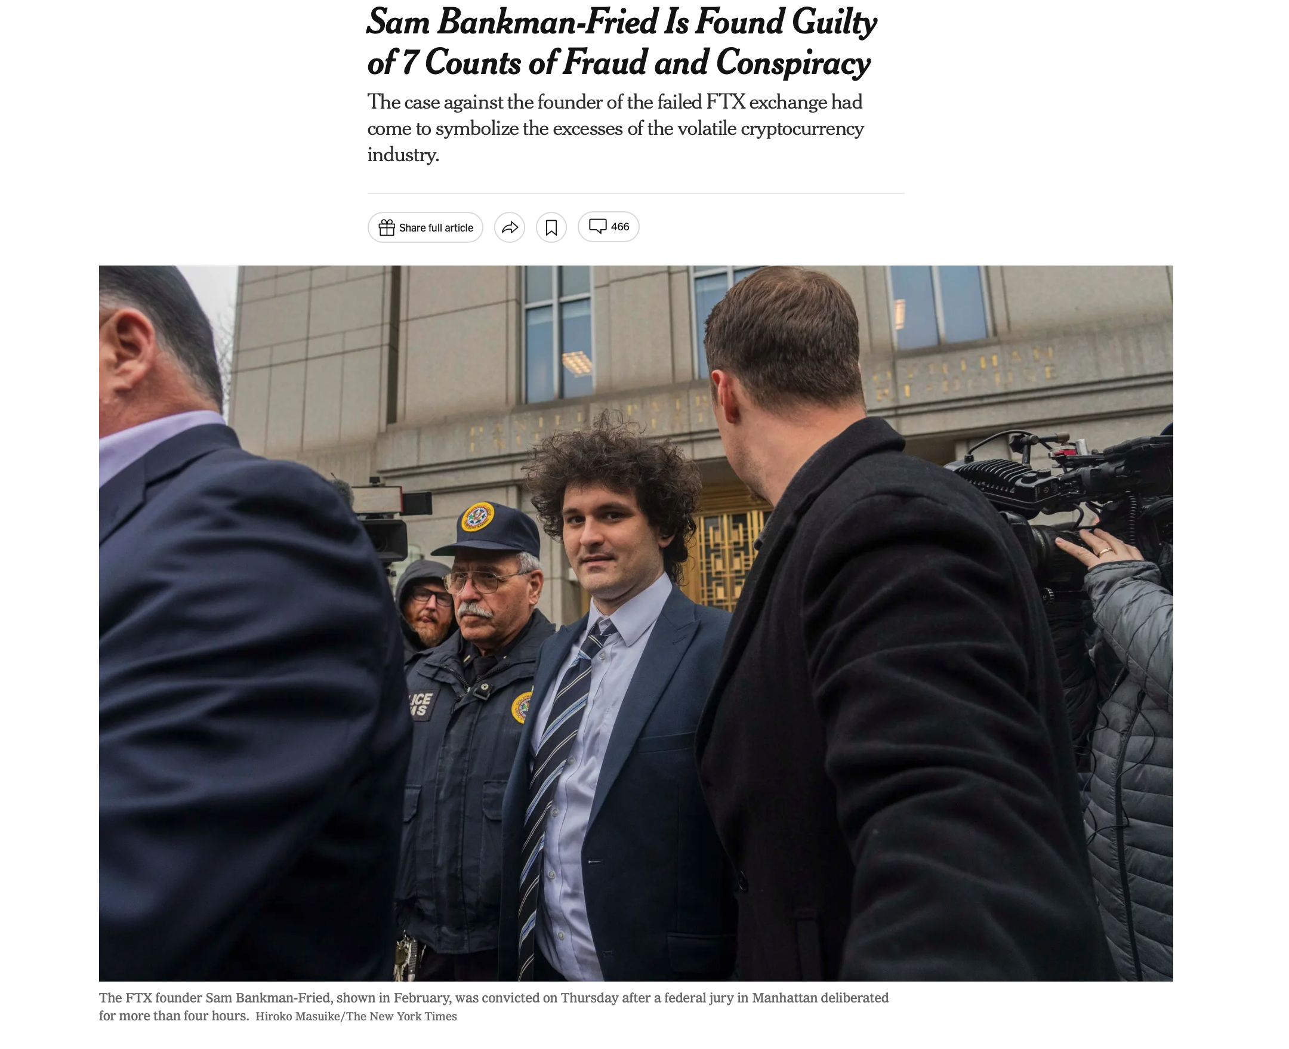
FTX / Careers / Power [NYT]

Slide 28
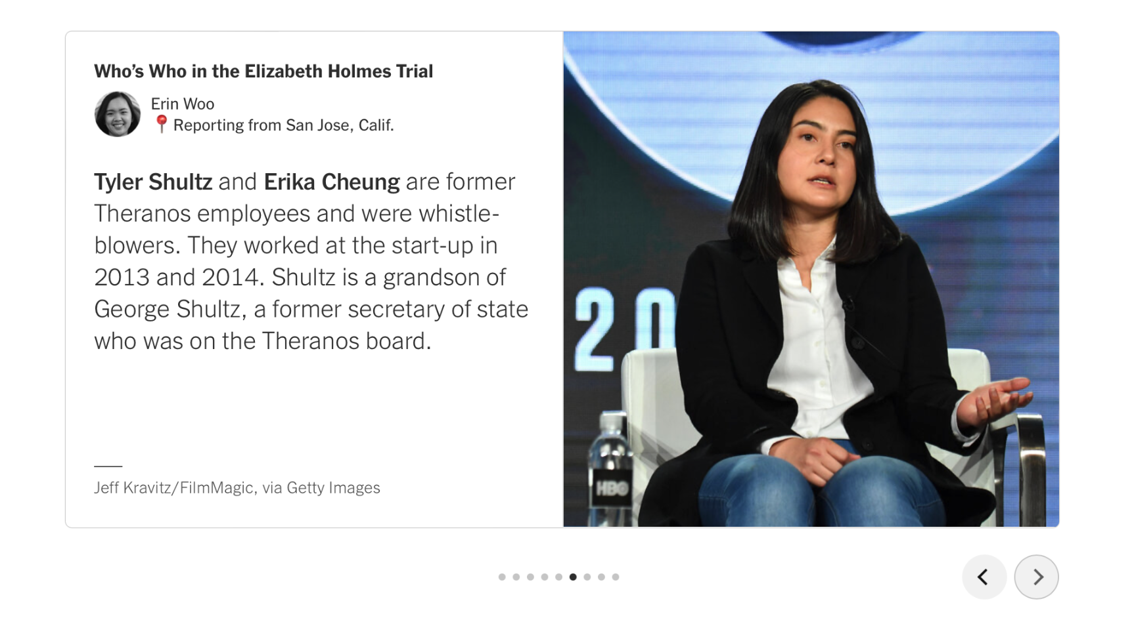
Other Corporate Scandals… Bears doing Good [NYT]

Slide 29
Question

Slide 30
Question

Slide 31
Question

Slide 32
Question

Slide 33
THANK YOU!

Slide 34
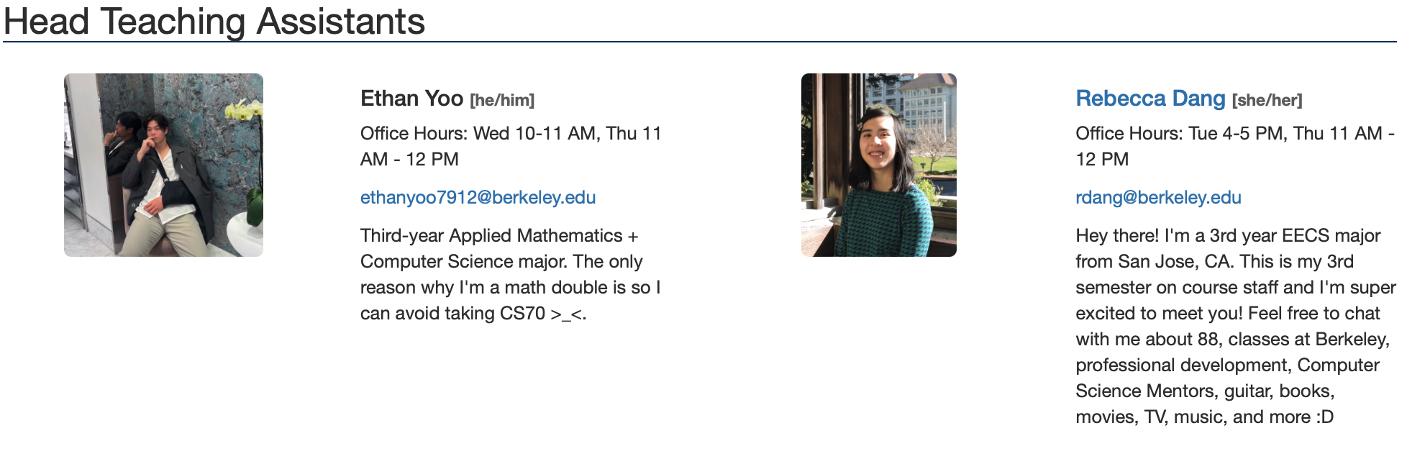
THANK YOU!

Slide 35
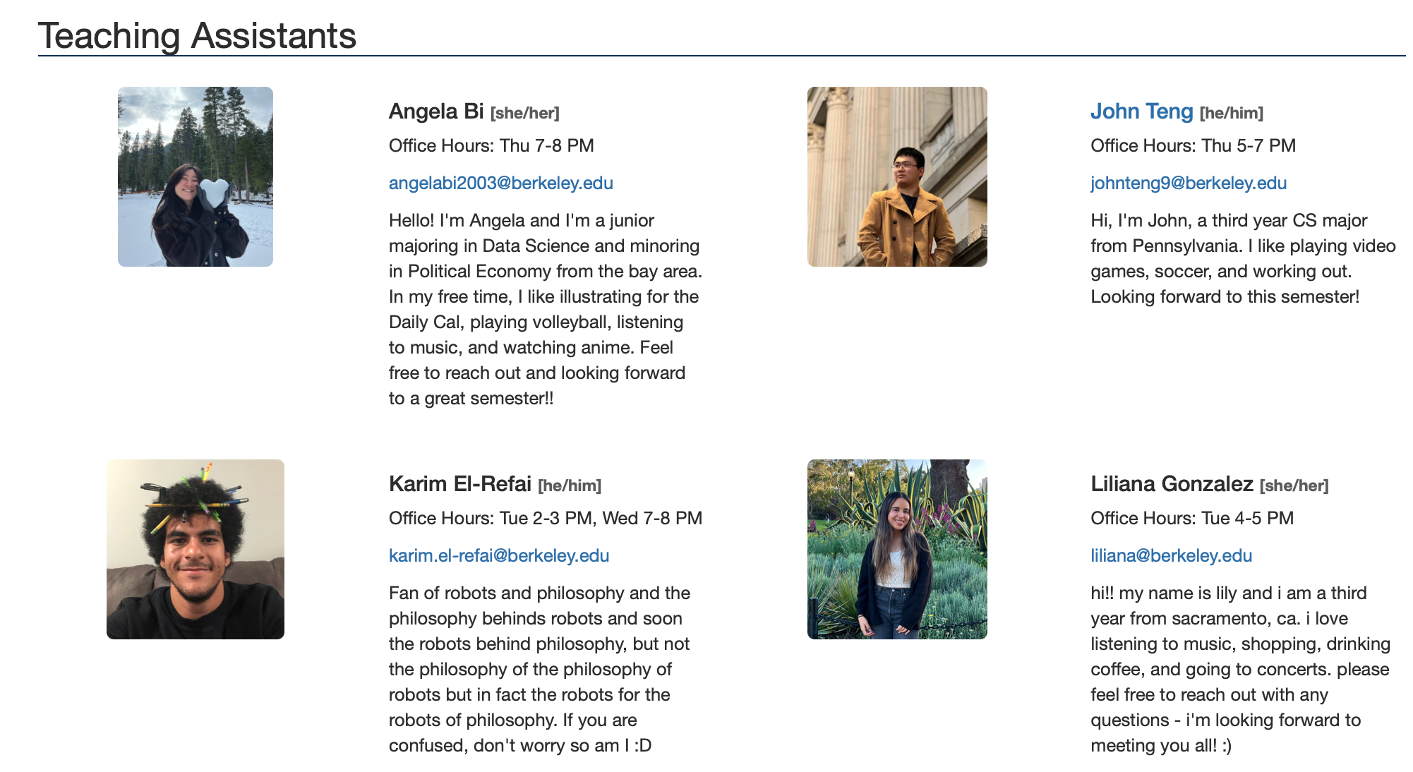
THANK YOU!

Slide 36
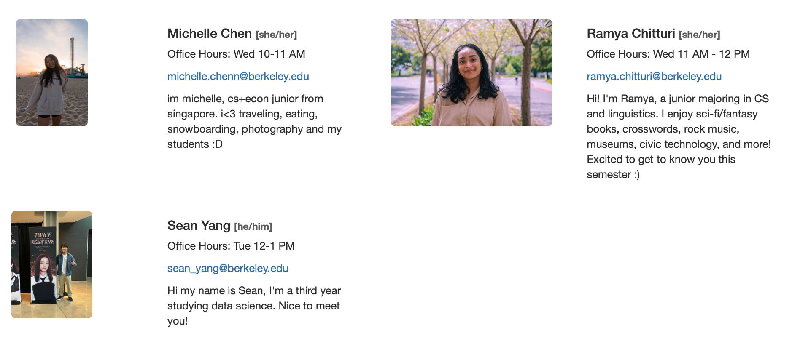
THANK YOU!

Slide 37
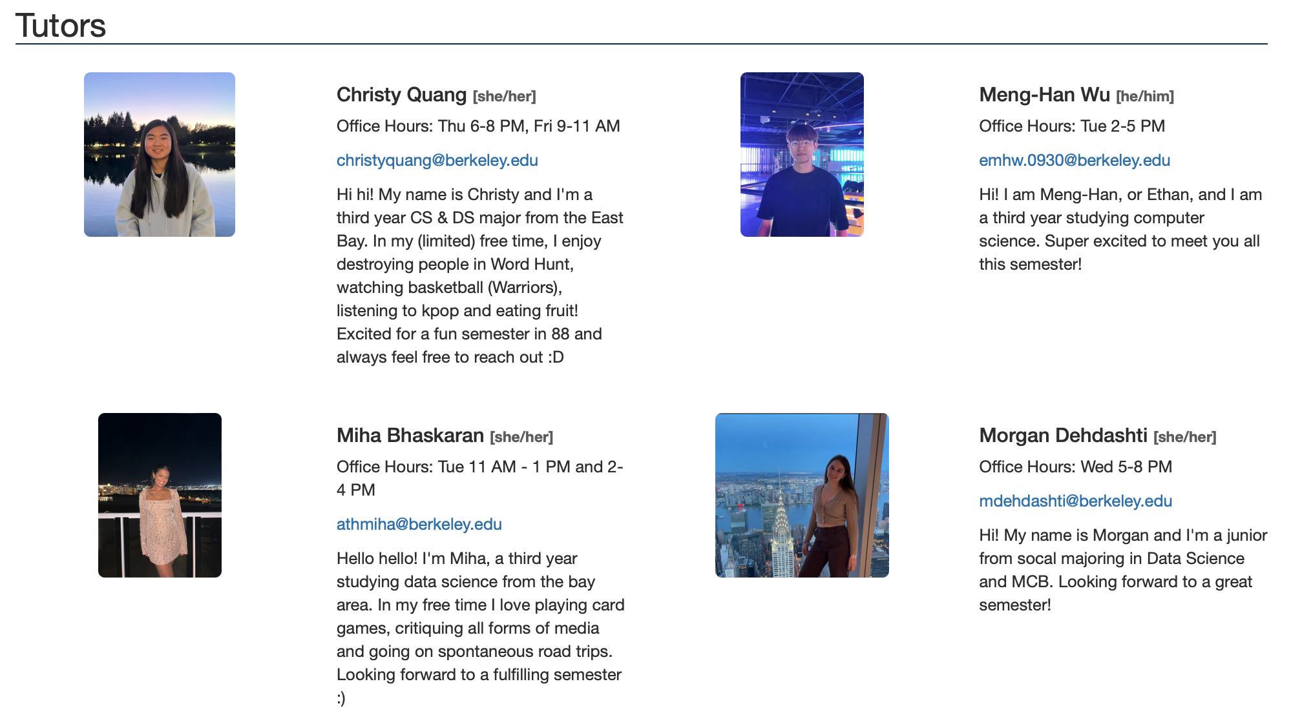
THANK YOU!

Slide 38
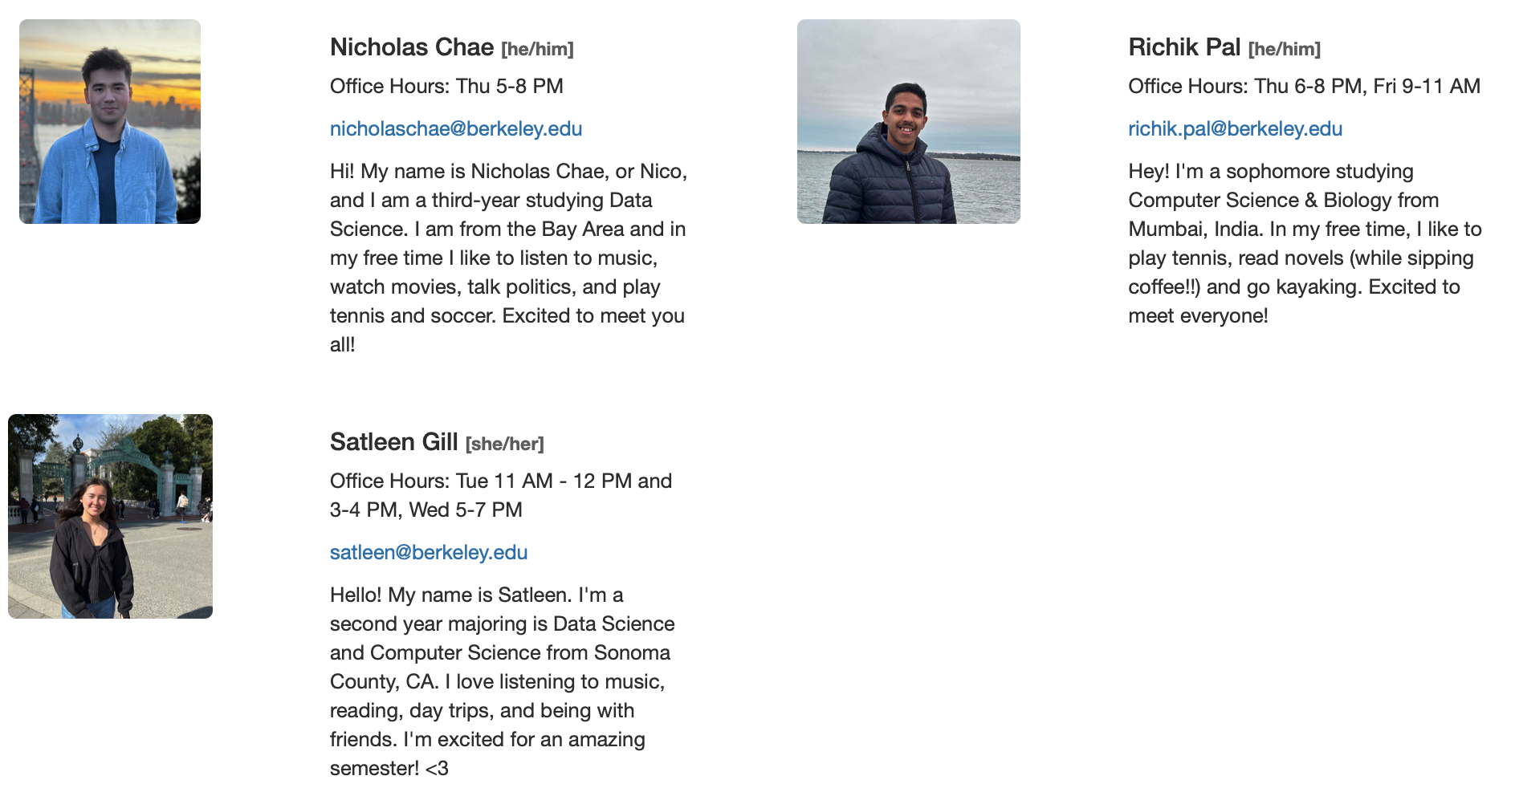
THANK YOU!

Slide 39
Anything Else?

